Slide 1
Applications Overview – Aug 2019 vs Aug 2020:
 |  |  | At 31 Aug 2019 |  |  |  | At 31 Aug 2020
Application Type |  |  | Licences | Licence Variations | Work Plans (Minerals) | Total | Licences | Licence Variations | Work Plans (Minerals) | Total
Total applications in the regulatory system |  |  | 138 | 117 | 84 | 339 | 261 | 136 | 80 | 477
 | Total applications with Applicant |  | 87 | 83 | 78 | 248 | 123 | 81 | 78 | 282
 | Total applications with Earth Resources Regulation |  | 51 | 34 | 6 | 91 | 138 | 55 | 2 | 195
 |  | # of applications with Earth Resources Regulation that are over statutory time frame | 16 | N/A* | 0 | 16 | 26 | N/A* | 0 | 26
* Variations do not have statutory time frames
i
The table shows the snapshot of the number of Licence Applications, Licence Variations and Work Plans (minerals) in the regulatory system as at 31 Aug 2019 and compares it with 31 Aug 2020.
Work Plans include New Work Plans and Work Plan Variations
Licence Variations includes but not limited to: Amalgamation, Cancellation, Change of Company Name, Consolidation, Full Surrender, Licence Area Change, Licence Conditions Change, Partial Cancellation / Surrender, Registration of Dealing, Renewal, Suspension and Extension and Transfers.

Slide 2
Applications Lodged and Applications Finalised
i
Applications lodged:
Shows the volume of Licence Applications, Licence Variations, Work Plans (Minerals) and Work Plan Variations (minerals) lodged over a 12 month period since Sept 2019 and the number lodged in Aug 2020.
Applications Finalised:
Shows the volume of Licence Applications, Licence Variations and Work Plans (Minerals) and Work Plans Variations (minerals) finalised over a 12 month period since Sept 2019 and those that were finalised in Aug 2020. Finalised Work Plans are those that were Approved (A), Refused(R) or Withdrawn (W).
Primary Mineral:
This table shows the primary commodity for each Licence and Work Plan finalised in the year.
Applications Lodged
APPLICATIONS LODGED Sept 2019 to Aug 2020 |  | 462
185 Licences | 254 Licence Variations | 23 Work Plans (Minerals)
APPLICATIONS LODGED in Aug 2020 |  | 41
23 Licences | 18 Licence Variations | 0 Work Plans (Minerals)
Applications Finalised
APPLICATIONS FINALISED Sept 2019 to Aug 2020 |  |  |  |  |  | 359
61 Licences |  |  | 276 Licence Variations |  |  | 22 Work Plans (Minerals)
50 A | 0 R | 11 W | 227 A | 2 R | 47 W | 15 A | 1 R | 6 W
APPLICATIONS FINALISED in Aug 2020 |  |  |  |  |  | 24
6 Licences |  |  | 17 Licence Variations |  |  | 1 Work Plans (Minerals)
2 A | 0 R | 4 W | 15 A | 1 R | 1 W | 1 A | 0 R | 0 W
Legend
A – Approved R - Refused W - Withdrawn
Primary Mineral – Approvals Sept 2019 to Aug 2020
Mineral | Gold | Base Metals (copper/ lead/ zinc) | Mineral Sands | Kaolin | Antimony | Gem Stone | Zircon | Gypsum | Ilmenite | Total
Licences Approved | 34 | 8 | 2 | 2 | 2 | 1 | 1 | 0 | 0 | 50
Work Plans Approved | 10 | 0 | 0 | 0 | 0 | 0 | 0 | 3 | 2 | 15

Slide 3
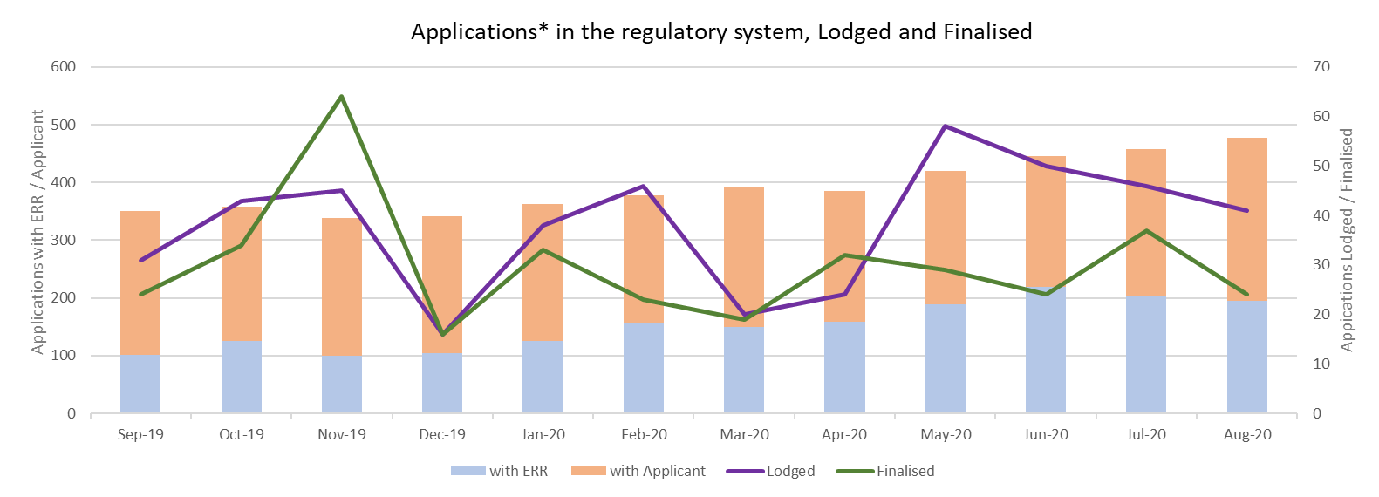
* Licence Applications, Licence Variations, New Work Plans(minerals) & Work Plan (minerals) Variations
i
This graph shows the number of Applications in the regulatory system over the last 12 months.
Stacked bar graph - Shows the total number of Applications in the regulatory system.
Line Graphs – Shows the total number of Applications that were lodged / finalised for the calendar month.

Slide 4
Median Days for Minerals Work Plan stages completed in Sept 2019 to Aug 2020
Work Plan stages in the below tables were from Work Plans where one or more stages were completed in the year
Statutory Endorsement Required
Total Work Plans that had one or more stages assessed in the 12 months: 16
Definitions:
Median Days #: Arranging the stage duration in order and then selecting the one in the middle duration.
Median is used to minimise the impact of outliers.
No. Work Plans*: The number of work plans that had that stage assessed in the year. A single Work Plan in Sept can have had a stage assessed multiple times.
Assigned To | Applicant | Earth Resources Regulation | Applicant | Earth Resources Regulation | Other Agency | Earth Resources Regulation | Applicant | Earth Resources Regulation
Stage Start to Stage End | New Plan to Lodged | Lodged to Assessed | Assessed to Resubmission | Resubmission to Agency Referral | Agency Referral to Returned to ERR | Returned to ERR to Endorsement | Endorsed to Seek Plan Permit | Plan permit to Finalised
Median Days# | 124 | 28 | 47 | 28 | 30 | 28 | 350 | 26
No. Work Plans* | 4 | 5 | 8 | 9 | 6 | 6 | 7 | 8
Statutory Endorsement Not Required
Total Work Plans that had one or more stages assessed in the 12 months: 22
i
A work plan goes through various stages from New to Approved. The tables identify the stages, the median days for each stage to be completed and the number of work plans that had the stage assessed from Sept 2019 to Aug 2020
Assigned To | Applicant | Earth Resources Regulation | Applicant | Earth Resources Regulation
Stage Start to Stage End | New Plan to Lodged | Lodged to Assessed | Assessed to Resubmission | Resubmission to Finalised
Median Days # | 25 | 28 | 17 | 25
No. Work Plans* | 17 | 14 | 12 | 7

