Slide 1
Work Authority Applications Overview – May 2018 vs May 2019:
 |  |  |  | At 31 May 2018 | At 31 May 2019
Total number of Applications in the regulatory system |  |  |  | 250 | 250
 | # of Work Authority Applications in the regulatory system |  |  | 134 | 126
 | # of Work Authority Work Plans in the regulatory system |  |  | 116 | 124
 |  | Work Authority Work Plans with Applicant |  | 111 | 115
 |  | Work Authority Work Plans with Earth Resources Regulation |  | 5 | 9
 |  |  | # of Work Plans with Earth Resources Regulation over statutory time frame | 0 | 0
i
The table shows the snapshot of the total number of Applications in the regulatory system as at 31 May 2019 and compares it with 31 May 2018.
The data is broken down to number of Work Authority and Work Plan applications.

Slide 2
New Work Authorities and Work Plans Lodged and Finalised
i
New Work Authorities lodged:
Shows the total number of Work Authority and Work Plans (WA) lodged over a 12 month period since June 2018 and the number of applications lodged in May 2019.
Work Authorities Finalised:
Shows the total number of Work Authority and Work Plans (WA) finalised over a 12 month period since June 2018 and those that were finalised in May 2019. Finalised work plans are those that were Approved, Refused or Withdrawn.
Rock Type:
This table shows the primary extractive resources for the Work Plans finalised in the period.
New Work Authority Lodged
NEW AUTHORITIES LODGED June 2018 TO MAY 2019 |  | 42
16 Work Authority | 26 Work Plans (WA)
NEW AUTHORITIES LODGED IN MAY 2019 |  | 3
1 Work Authority | 2 Work Plans (WA)
Work Authority Finalised
AUTHORITIES FINALISED June 2018 TO May 2019 |  |  |  |  | 47
24 Work Authority |  |  | 23 Work Plan (WA)
9 A | 0 R | 15 W | 15 A | 0 R |  | 8 W
AUTHORITIES FINALISED IN MAY 2019 |  |  |  |  | 0
0 Work Authority |  |  | 0 Work Plan (WA)
0 A | 0 R | 0 W | 0 A | 0 R |  | 0 W
Legend
A – Approved R - Refused W - Withdrawn
Rock type – Work Authority and Work Plans approved June 2018 to May 2019
Rock Type | Sand | Basalt New | Gravel | Lime Stone | Sand & Gravel | Clay | Sedimentary | Total
Work Plans Approved | 4 | 3 | 3 | 2 | 1 | 1 | 1 | 15
Work Authority Approved | 4 | 2 | 2 | 1 | 0 | 0 | 0 | 9

Slide 3
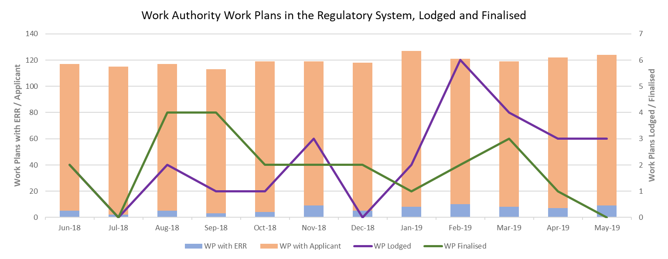
i
This graph shows the number of Work Plans (WA) in the regulatory system over the last 12 months.
Stacked bar graph - Shows the total number of Work Plans in the regulatory system.
Line Graphs – Shows the total number of Work Plans that were lodged / finalised for the calendar month.

Slide 4
Median Days for Work Authority work plan stages completed in June 2018 to May 2019
Work Plan stages in the below tables were from Work Plans where one or more stages were completed in the year
Statutory Endorsement Required
Definitions:
Median Days #: Arranging the stage duration in order and then selecting the one in the middle duration.
Median is used to minimise the impact of outliers.
No. Work Plans*: The number of work plans that had that stage assessed in the year. A single Work Plan June have had a stage assessed multiple times.
Total Work Plans that had one or more stages assessed in the 12 months: 32
Assigned To | Applicant | Earth Resources Regulation | Applicant | Earth Resources Regulation | Other Agency | Earth Resources Regulation | Applicant | Earth Resources Regulation
Stage Start to Stage End | New Plan to Lodged | Lodged to Assessed | Assessed to Resubmission | Resubmission to Agency Referral | Agency Referral to Returned to ERR | Returned to ERR to Endorsement | Endorsed to Plan Permit | Plan permit to Finalised
Median Days # | 140 | 25 | 113 | 27 | 30 | 27 | 200 | 24
No. Work Plans* | 12 | 11 | 16 | 14 | 10 | 12 | 13 | 13
Statutory Endorsement Not Required
Total Work Plans that had one or more stages assessed in the 12 month: 22
i
Assigned To | Applicant | Earth Resources Regulation | Applicant | Earth Resources Regulation
Stage Start to Stage End | New Plan to Lodged | Lodged to Assessed | Assessed to Resubmission | Resubmission to Finalised
Median Days # | 254 | 28 | 123 | 31
No. Work Plans* | 16 | 9 | 9 | 2
A work plan goes through various stages from New to Finalised. The tables identify the stages, the median days for each stage to be completed and the number of work plans that had the stage assessed from June 2018 to May 2019.

