Slide 1
Applications Overview – May 2018 vs May 2019:
 |  |  | At 31 May 2018 |  |  |  | At 31 May 2019
Application Type |  |  | Licences | Variations | Work Plans (Minerals) | Total | Licences | Variations | Work Plans (Minerals) | Total
Total applications in the regulatory system |  |  | 115 | 109 | 87 | 311 | 146 | 100 | 80 | 326
 | Total applications with Applicant |  | 84 | 69 | 84 | 237 | 87 | 65 | 78 | 230
 | Total applications with Earth Resources Regulation |  | 31 | 40 | 3 | 74 | 59 | 35 | 2 | 96
 |  | # of applications with Earth Resources Regulation that are over statutory time frame | 5 | N/A* | 1 | 6 | 17 | N/A* | 0 | 17
* Variations do not have statutory time frames
i
The table shows the snapshot of the number of Licence Applications, Licence Variations and Work Plans (minerals) in the regulatory system as at 31 May 2018 and compares it with 31 May 2019.

Slide 2
New Applications Lodged and Applications Finalised
i
New Applications lodged:
Shows the volume of Licence Applications, Licence Variations and Work Plans (minerals) lodged over a 12 month period since June 2018 and the number lodged in May 2019.
Applications Finalised:
Shows the volume of Licence Applications, Licence Variations and Work Plans (minerals) finalised over a 12 month period since June 2018 and those that were finalised in May 2019. Finalised Work Plans are those that were Approved (A), Refused(R) or Withdrawn (W).
Primary Mineral:
This table shows the primary commodity for each Licence and Work Plan finalised in the year.
New Applications Lodged
NEW APPLICATIONS LODGED JUN 2018 to MAY 2019 |  | 325
93 Licences | 208 Variations | 24 Work Plans (Minerals)
NEW APPLICATIONS LODGED IN MAY 2019 |  | 25
10 Licences | 12 Variations | 3 Work Plans (Minerals)
Applications Finalised
APPLICATIONS FINALISED JUN 2018 to MAY 2019 |  |  |  |  |  | 418
63 Licences |  |  | 334 Variations |  |  | 21 Work Plans (Minerals)
50 A | 0 R | 13 W | 282 A | 2 R | 50 W | 18 A | 0 R | 3 W
APPLICATIONS FINALISED IN MAY 2019 |  |  |  |  |  | 41
4 Licences |  |  | 37 Variations |  |  | 0 Work Plans (Minerals)
4 A | 0 R | 0 W | 34 A | 0 R | 3 W | 0 A | 0 R | 0 W
Legend
A – Approved R - Refused W - Withdrawn
Primary Mineral – Approvals June 2018 to May 2019
Mineral | Gold | Base Metals (copper/ lead/ zinc) | Gypsum | Antimony | Mineral Sands | Andalusite | Rare Earth | Copper | Zircon | Ilmenite | Coal | Total
Licences Approved | 28 | 5 | 6 | 4 | 4 | 1 | 1 | 1 | 0 | 0 | 0 | 50
Work Plans Approved | 9 | 0 | 0 | 0 | 0 | 0 | 0 | 4 | 2 | 2 | 1 | 18

Slide 3
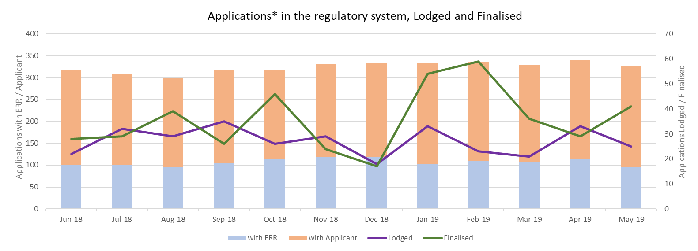
* Licence Applications, Variations & Work Plans(minerals)
i
This graph shows the number of Applications in the regulatory system over the last 12 months.
Stacked bar graph - Shows the total number of Applications in the regulatory system.
Line Graphs – Shows the total number of Applications that were lodged / finalised for the calendar month.

Slide 4
Median Days for Minerals Work Plan stages completed in June 2018 to May 2019
Work Plan stages in the below tables were from Work Plans where one or more stages were completed in the year
Statutory Endorsement Required
Total Work Plans that had one or more stages assessed in the 12 months: 8
Definitions:
Median Days #: Arranging the stage duration in order and then selecting the one in the middle duration.
Median is used to minimise the impact of outliers.
No. Work Plans*: The number of work plans that had that stage assessed in the year. A single Work Plan June have had a stage assessed multiple times.
Assigned To | Applicant | Earth Resources Regulation | Applicant | Earth Resources Regulation | Other Agency | Earth Resources Regulation | Applicant | Earth Resources Regulation
Stage Start to Stage End | New Plan to Lodged | Lodged to Assessed | Assessed to Resubmission | Resubmission to Agency Referral | Agency Referral to Returned to ERR | Returned to ERR to Endorsement | Endorsed to Seek Plan Permit | Plan permit to Finalised
Median Days# | 63 | 26 | 29 | 15 | 28 | 26 | 0 | 0
No. Work Plans* | 5 | 5 | 4 | 4 | 4 | 5 | 0 | 0
Statutory Endorsement Not Required
Total Work Plans that had one or more stages assessed in the 12 months: 28
i
A work plan goes through various stages from New to Finalised. The tables identify the stages, the median days for each stage to be completed and the number of work plans that had the stage assessed from May 2018 to May 2019
Assigned To | Applicant | Earth Resources Regulation | Applicant | Earth Resources Regulation
Stage Start to Stage End | New Plan to Lodged | Lodged to Assessed | Assessed to Resubmission | Resubmission to Finalised
Median Days # | 51 | 19 | 47 | 28
No. Work Plans* | 16 | 13 | 21 | 18

