Slide 1
Applications Overview – December 2017 vs December 2018:
 |  |  | At 31 December 2017 |  |  |  | At 31 December 2018
Application Type |  |  | Licences | Variations | Work Plans (Minerals) | Total | Licences | Variations | Work Plans (Minerals) | Total
Total applications in the regulatory system |  |  | 105 | 124 | 83 | 314 | 124 | 123 | 84 | 331
 | Total applications with Applicant |  | 74 | 72 | 70 | 216 | 66 | 66 | 80 | 212
 | Total applications with Earth Resources Regulation |  | 31 | 52 | 15 | 98 | 58 | 57 | 4 | 119
 |  | # of applications with Earth Resources Regulation that are over statutory time frame | 2 | N/A* | 9 | 11 | 14 | N/A* | 0 | 14
* Variations do not have statutory time frames
i
The table shows the snapshot of the number of Licence Applications, Licence Variations and Work Plans (minerals) in the regulatory system as at 31 December 2017 and compares it with 31 December 2018.

Slide 2
New Applications Lodged and Applications Finalised
i
New Applications lodged:
Shows the volume of Licence Applications, Licence Variations and Work Plans (minerals) lodged over a 12 month period since January 2018 and the number lodged in December 2018.
Applications Finalised:
Shows the volume of Licence Applications, Licence Variations and Work Plans (minerals) finalised over a 12 month period since January 2018 and those that were finalised in December 2018. Finalised Work Plans are those that were Approved (A), Refused(R) or Withdrawn (W).
Primary Mineral:
This table shows the primary commodity for each Licence and Work Plan finalised in the year.
New Applications Lodged
NEW APPLICATIONS LODGED JAN 2018 to DEC 2018 |  | 325
101 Licences | 194 Variations | 30 Work Plans (Minerals)
NEW APPLICATIONS LODGED IN DECEMBER 2018 |  | 18
6 Licences | 12 Variations | 0 Work Plans (Minerals)
Applications Finalised
APPLICATIONS FINALISED JAN 2018 to DEC 2018 |  |  |  |  |  | 370
79 Licences |  |  | 262 Variations |  |  | 29 Work Plans (Minerals)
67 A | 0 R | 12 W | 230 A | 3 R | 29 W | 21 A | 0 R | 8 W
APPLICATIONS FINALISED IN DECEMBER 2018 |  |  |  |  |  | 17
1 Licences |  |  | 15 Variations |  |  | 1 Work Plans (Minerals)
1 A | 0 R | 0 W | 11 A | 0 R | 4 W | 1 A | 0 R | 0 W
Legend
A – Approved R - Refused W - Withdrawn
Primary Mineral – Approvals January 2018 to December 2018
Mineral | Gold | Mineral Sands | Gypsum | Antimony | Base Metals (copper/ lead/ zinc) | Andalusite | Cobalt | Phosphate | Zircon | Ilmenite | Copper | Coal | Total
Licences Approved | 42 | 8 | 5 | 5 | 4 | 1 | 1 | 1 | 0 | 0 | 0 | 0 | 67
Work Plans Approved | 11 | 0 | 0 | 2 | 0 | 0 | 0 | 0 | 2 | 1 | 3 | 2 | 21

Slide 3
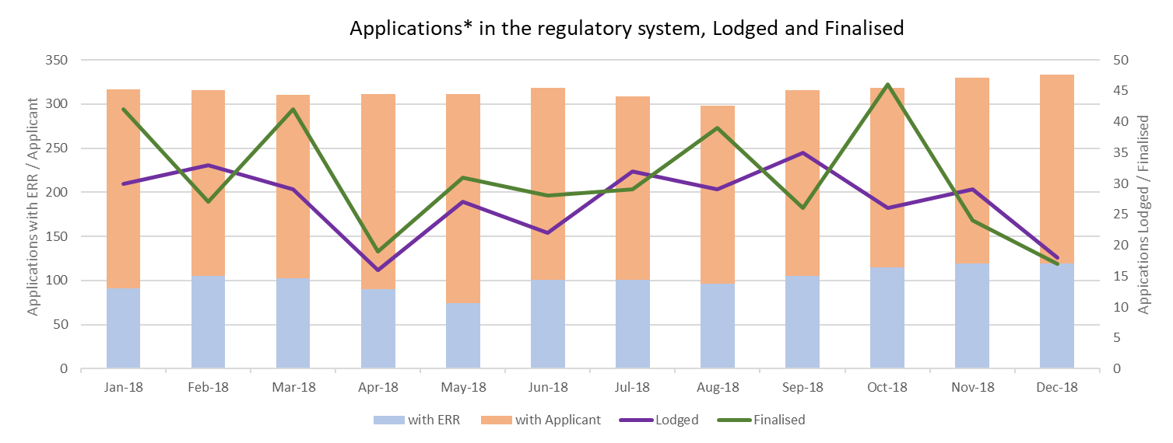
* Licence Applications, Variations & Work Plans(minerals)
i
This graph shows the number of Applications in the regulatory system over the last 12 months.
Stacked bar graph - Shows the total number of Applications in the regulatory system.
Line Graphs – Shows the total number of Applications that were lodged / finalised for the calendar month.

Slide 4
Median Days for Minerals Work Plan stages completed in January 2018 to December 2018
Work Plan stages in the below tables were from Work Plans where one or more stages were completed in the year
Statutory Endorsement Required
Total Work Plans that had one or more stages assessed in the 12 months: 7
Definitions:
Median Days #: Arranging the stage duration in order and then selecting the one in the middle duration.
Median is used to minimise the impact of outliers.
No. Work Plans*: The number of work plans that had that stage assessed in the year. A single Work Plan may have had a stage assessed multiple times.
Assigned To | Applicant | Earth Resources Regulation | Applicant | Earth Resources Regulation | Other Agency | Earth Resources Regulation | Applicant | Earth Resources Regulation
Stage Start to Stage End | New Plan to Lodged | Lodged to Assessed | Assessed to Resubmission | Resubmission to Agency Referral | Agency Referral to Returned to ERR | Returned to ERR to Endorsement | Endorsed to Seek Plan Permit | Plan permit to Finalised
Median Days# | 56 | 26 | 29 | 23 | 25 | 28 | 0 | 0
No. Work Plans* | 4 | 4 | 7 | 6 | 3 | 3 | 0 | 0
Statutory Endorsement Not Required
Total Work Plans that had one or more stages assessed in the 12 months: 43
i
A work plan goes through various stages from New to Finalised. The tables identify the stages, the median days for each stage to be completed and the number of work plans that had the stage assessed from January 2018 to December 2018
Assigned To | Applicant | Earth Resources Regulation | Applicant | Earth Resources Regulation
Stage Start to Stage End | New Plan to Lodged | Lodged to Assessed | Assessed to Resubmission | Resubmission to Finalised
Median Days # | 93 | 20 | 28 | 28
No. Work Plans* | 24 | 26 | 25 | 21

